Slide 1











BY
Pasindu Mahima
Search . . .
NGATOR
LEARNING
SAD PRESENTATIONS
learn.ngator.com

Slide 2




BY
Pasindu Mahima
Search . . .
IMPORTANT POINTS TO REMEMBER
ACTION LISTENERS
JFRAME OPERATIONS
SOFTWARE FINALIZING
JASPER REPORTING
java.awt.event.*
javax.swing.event.*
java.beans.PropertyChangeEvent
GUI
Components
Creating a report
Sub Reporting
EXIT_ON_CLOSE
DO_NOTHING
DISPOSE
Logger
Unit Testing
jar, exe and setup files

Slide 3
BY
Pasindu Mahima
Search . . .
(java.awt and javax.swing)
ACTION LISTENERS
actionPerformed
stateChange
focusGained / focusLost
itemStateChange
keyPressed / keyReleased / keyTyped
mouseClicked / mouseEntered / mouseExited / mouseReleased
propertyChange (java.beans.PropertyChangeEvent)

Slide 4
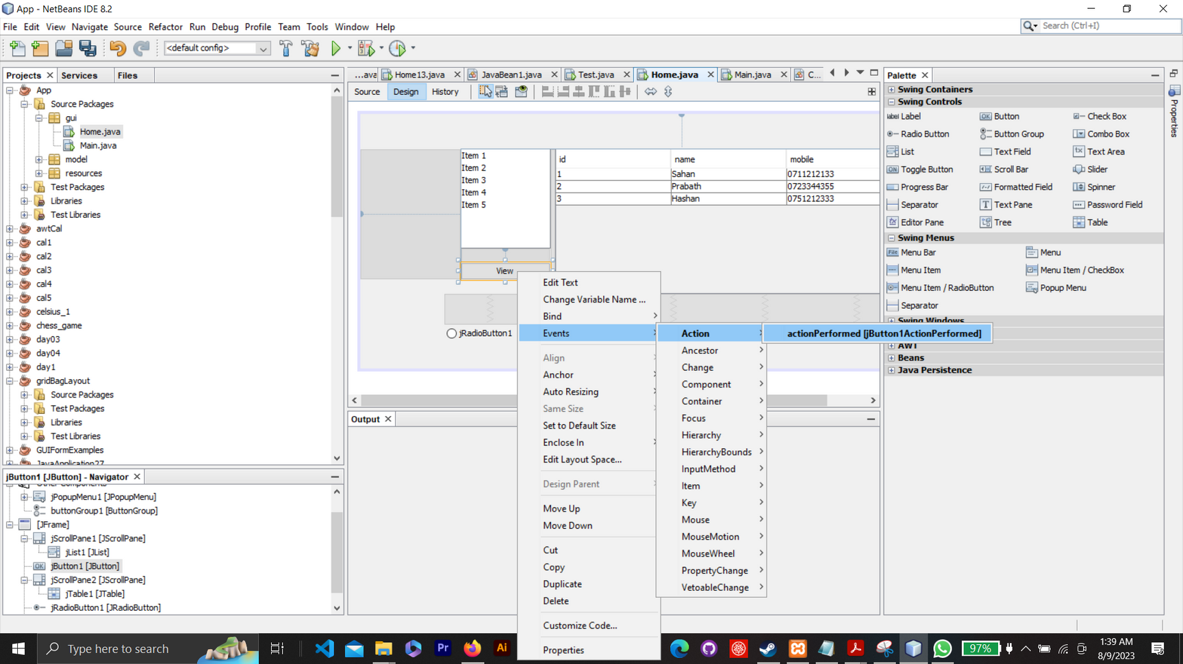
BY
Pasindu Mahima
Search . . .
actionPerformed (java.awt.event.actionPerformed)

Slide 5
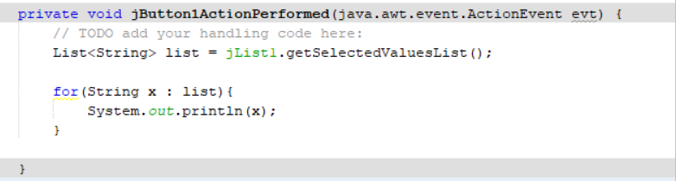
BY
Pasindu Mahima
Search . . .
actionPerformed (java.awt.event.actionPerformed)

Slide 6
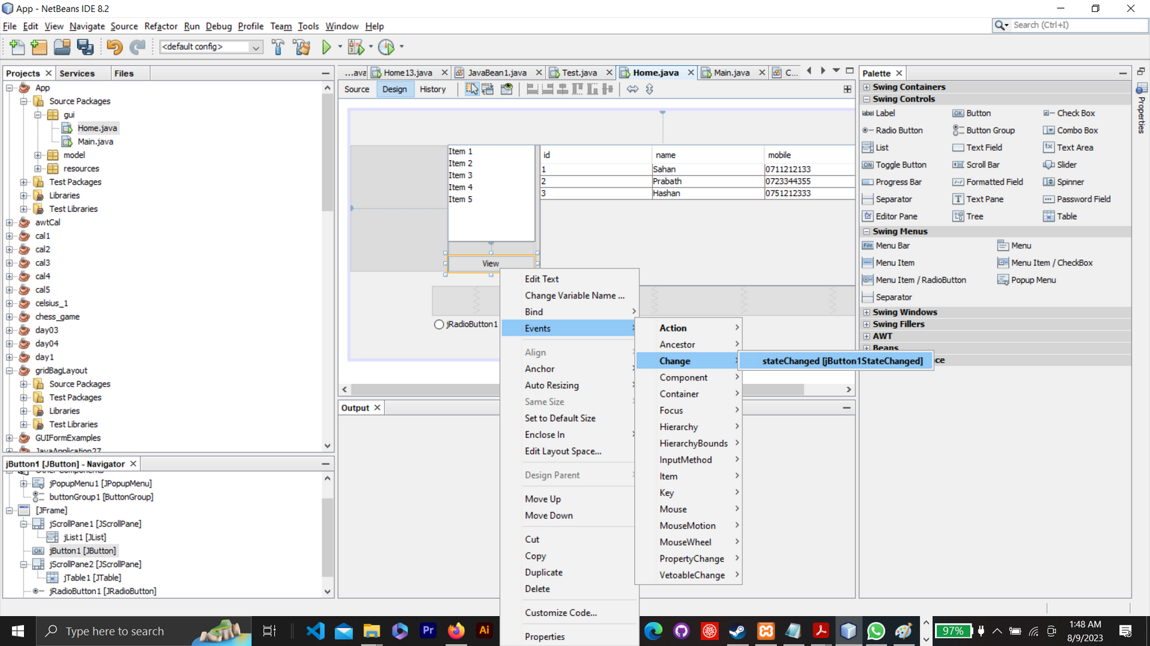
BY
Pasindu Mahima
Search . . .
stateChange (javax.swing.event.ChangeEvent)

Slide 7
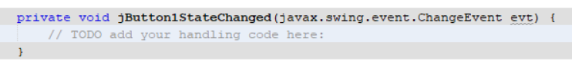
BY
Pasindu Mahima
Search . . .
stateChange (javax.swing.event.ChangeEvent)
In Java, stateChange typically refers to an event that denotes a change in state for an object. One of the most common uses of this term is with the ChangeEvent and ChangeListener classes in the Java Swing library, which are used for components that can change their state, such as JSlider, JSpinner, and ButtonModel.

Slide 8
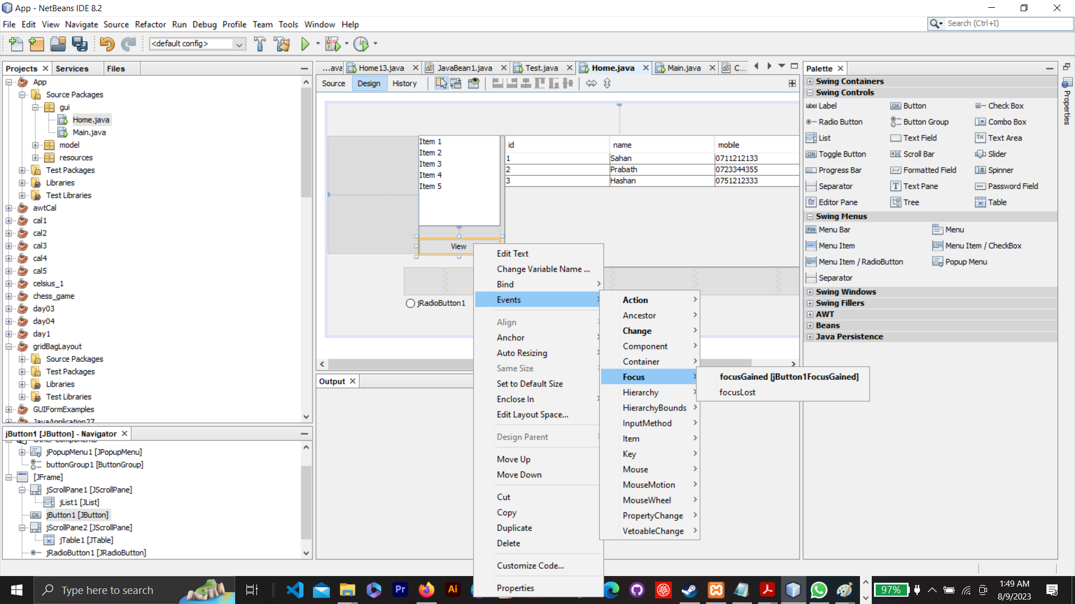
BY
Pasindu Mahima
Search . . .
focusGained / focusLost (java.awt.event.FocusEvent)

Slide 9
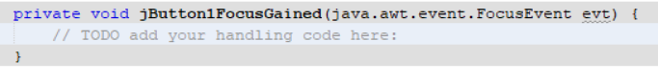
BY
Pasindu Mahima
Search . . .
focusGained / focusLost (java.awt.event.FocusEvent)

Slide 10
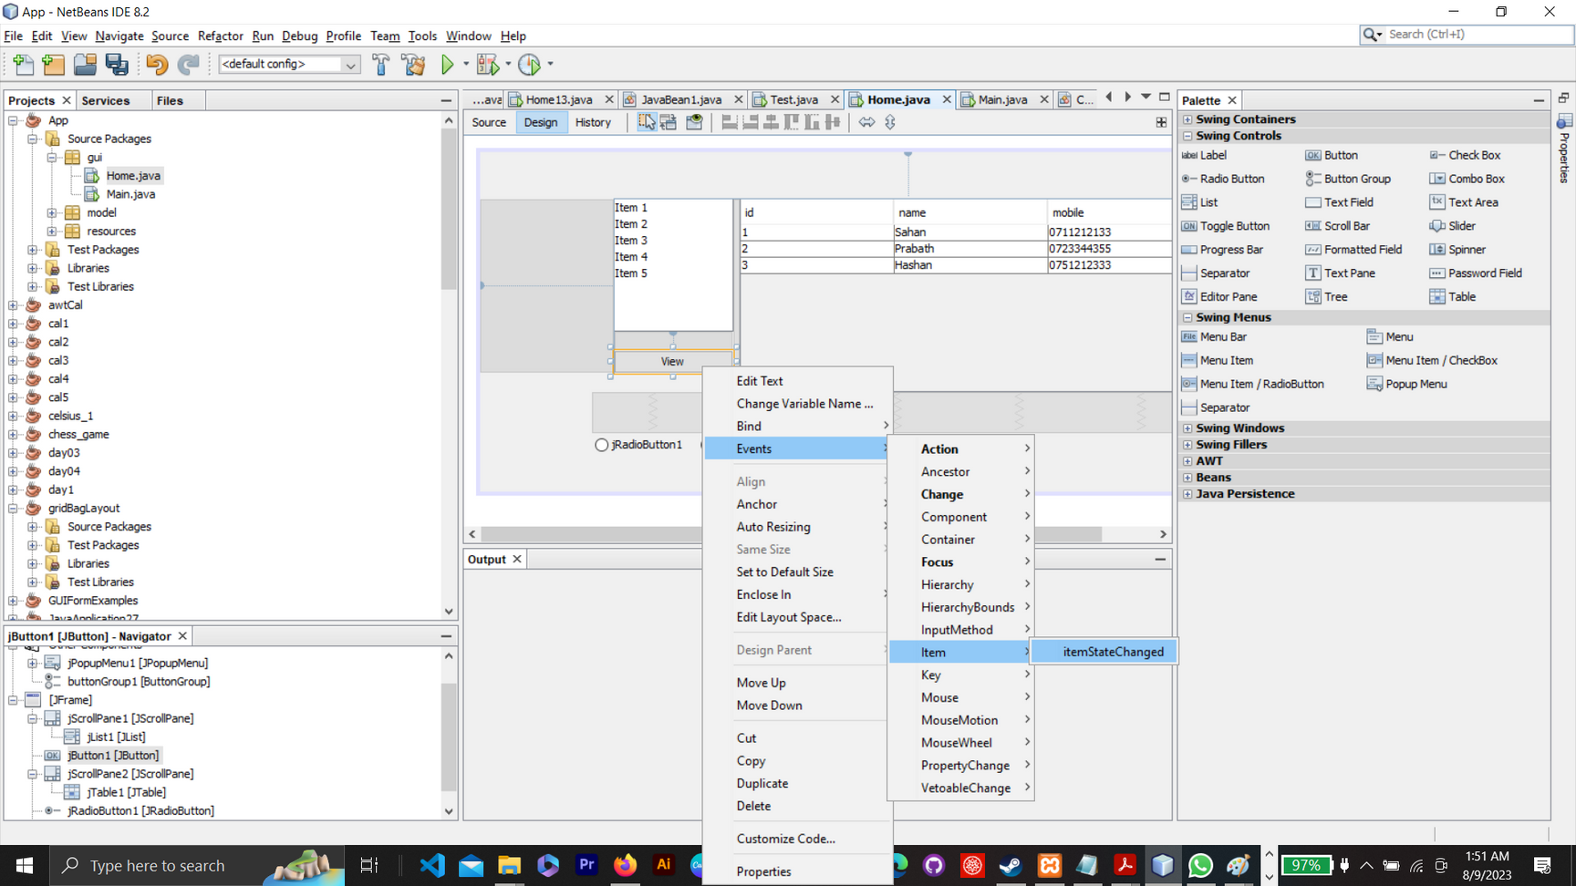
BY
Pasindu Mahima
Search . . .
itemStateChange (java.awt.event.ItemEvent)

Slide 11
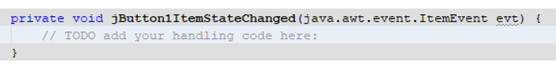
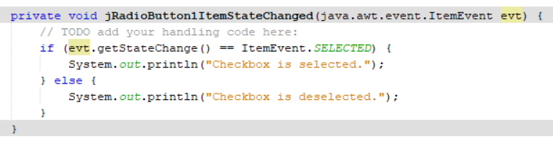
BY
Pasindu Mahima
Search . . .
itemStateChange (java.awt.event.ItemEvent)
Typical Usage: When you want to respond to a user selecting or deselecting an item.

Slide 12
BY
Pasindu Mahima
Search . . .
What's the difference between stateChange and itemStateChange?
Change event (stateChanged method call) is raised 2 times when you press a button; and raised 2 time again when you release a button. This tells us that a button has more than 2 states: selected and deselected.
Item event (itemStateChanged method call) is raised only once when you release a button.

Slide 13
BY
Pasindu Mahima
Search . . .
What's the difference between actionListener, stateListener and itemListener?
Action event raised only once when you release a button.
Change event (stateChanged method call) is raised 2 times when you press a button; and raised 2 time again when you release a button. This tells us that a button has more than 2 states: selected and deselected.
Item event (itemStateChanged method call) is raised only once when you release a button.
In a button group, if one button is selected, other selected buttons will be deselected. Events #10 and #11 show that when "Off" is selected, "On" is deselected.
Reference - http://www.herongyang.com/Swing/JRadioButton-ActionListener-ChangeListener-ItemListener.html

Slide 14
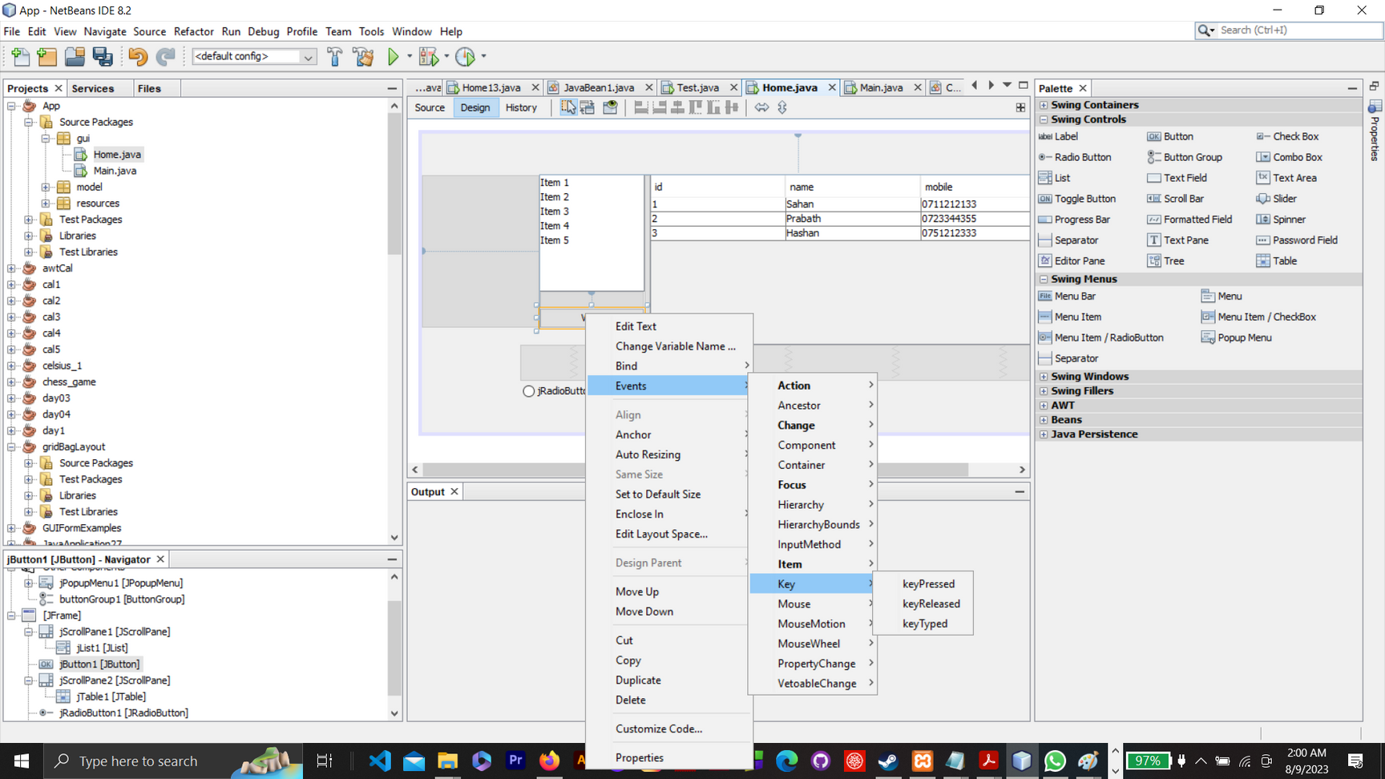
BY
Pasindu Mahima
Search . . .
keyPressed / keyReleased / keyTyped (java.awt.event.KeyEvent)

Slide 15
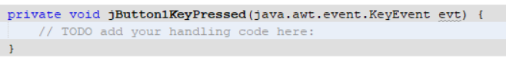
BY
Pasindu Mahima
Search . . .
keyPressed / keyReleased / keyTyped (java.awt.event.KeyEvent)

Slide 16
BY
Pasindu Mahima
Search . . .
keyPressed / keyReleased / keyTyped
Modifier Keys
VK_SHIFT: Shift key.
VK_CONTROL: Control key.
VK_ALT: Alt key.
VK_META: Meta key (often maps to the Windows key on PC or the Command key on Mac).
Function Keys
VK_F1 through VK_F12: Function keys F1 through F12.

Slide 17
BY
Pasindu Mahima
Search . . .
keyPressed / keyReleased / keyTyped
Navigation Keys
VK_UP: Up arrow key.
VK_DOWN: Down arrow key.
VK_LEFT: Left arrow key.
VK_RIGHT: Right arrow key.
VK_HOME: Home key.
VK_END: End key.
VK_PAGE_UP: Page Up key.
VK_PAGE_DOWN: Page Down key.
Alphanumeric Keys
VK_A through VK_Z: Alphabetic keys A through Z.
VK_0 through VK_9: Numeric keys 0 through 9.

Slide 18
BY
Pasindu Mahima
Search . . .
keyPressed / keyReleased / keyTyped
Special Keys
VK_ENTER: Enter or Return key.
VK_BACK_SPACE: Backspace key.
VK_TAB: Tab key.
VK_ESCAPE: Escape key.
VK_SPACE: Space key.
VK_DELETE: Delete key.
VK_PERIOD: Period or dot key.

Slide 19
BY
Pasindu Mahima
Search . . .
keyPressed / keyReleased / keyTyped
Numeric Keypad Keys
VK_NUMPAD0 through VK_NUMPAD9: Numeric keypad keys 0 through 9.
VK_MULTIPLY: Multiplication key on the numeric keypad.
VK_ADD: Addition key on the numeric keypad.
VK_SUBTRACT: Subtraction key on the numeric keypad.
VK_DIVIDE: Division key on the numeric keypad.
Other Keys
VK_NUMPAD0 through VK_NUMPAD9: Numeric keypad keys 0 through 9.
VK_MULTIPLY: Multiplication key on the numeric keypad.
VK_ADD: Addition key on the numeric keypad.
VK_SUBTRACT: Subtraction key on the numeric keypad.
VK_DIVIDE: Division key on the numeric keypad.

Slide 20
BY
Pasindu Mahima
Search . . .
keyPressed / keyReleased / keyTyped
Special Points to remember -
Space Bar:
VK_SPACE
Integer Value: 32
Letter 'a':
VK_A
Integer Value: 65
Note: The value corresponds to both lowercase 'a' and uppercase 'A' because the KeyEvent distinguishes the case through other means (e.g., checking if the Shift modifier is active).
Letter 'A':
Also VK_A
Integer Value: 65
As mentioned, the key event for both 'A' and 'a' is the same. To determine if it's an uppercase 'A', you'd typically check if the Shift key is pressed or if the Caps Lock is active.

Slide 21
BY
Pasindu Mahima
Search . . .
keyPressed / keyReleased / keyTyped
Special Points to remember -
4.Letter 'z':
VK_Z
Integer Value: 90
Again, this value represents both 'z' and 'Z'. The distinction between the two is based on the state of the Shift key or the Caps Lock.

Slide 22
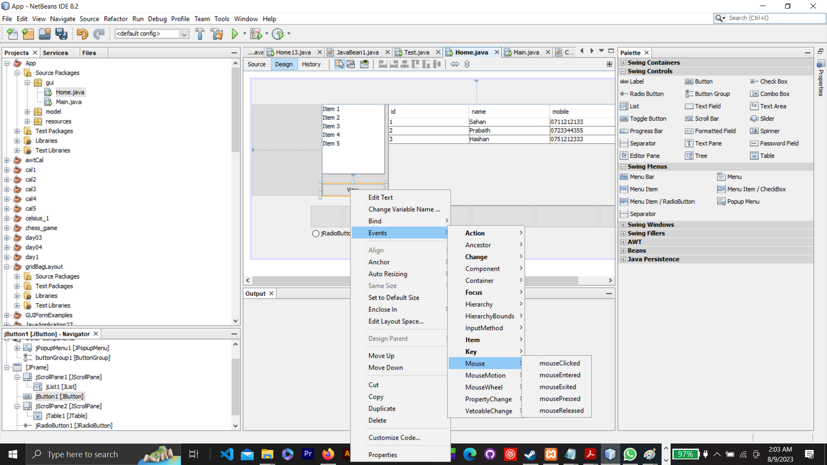
BY
Pasindu Mahima
Search . . .
mouseClicked / mouseEntered / mouseExited / mouseReleased
(java.awt.event.MouseEvent)

Slide 23
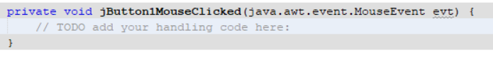
BY
Pasindu Mahima
Search . . .
mouseClicked / mouseEntered / mouseExited / mouseReleased
(java.awt.event.MouseEvent)

Slide 24
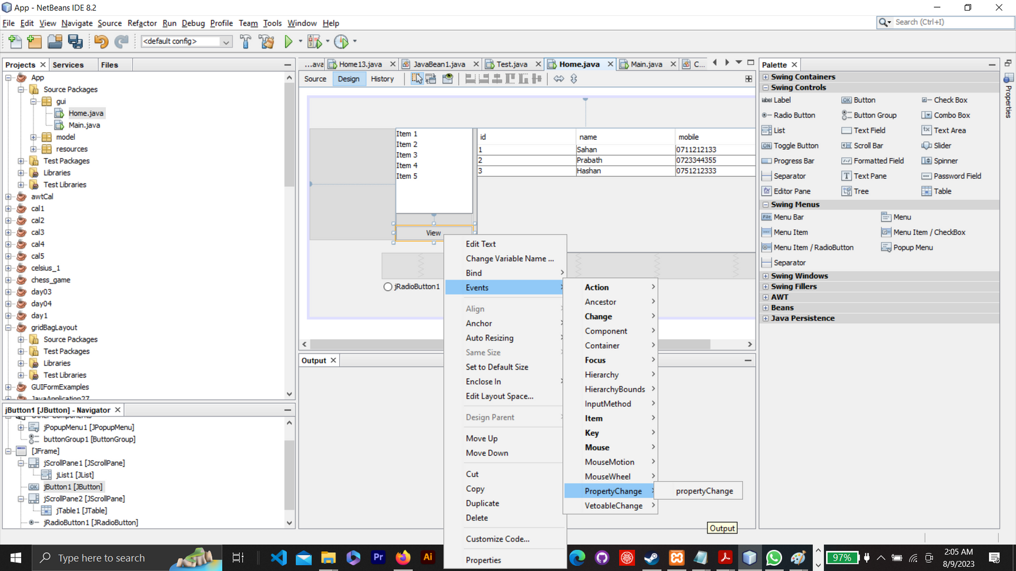
BY
Pasindu Mahima
Search . . .
propertyChange (java.beans.PropertyChangeEvent)

Slide 25
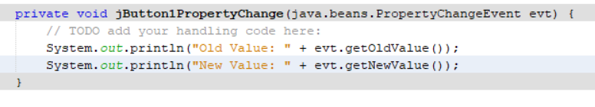
BY
Pasindu Mahima
Search . . .
propertyChange (java.beans.PropertyChangeEvent)
Typical Usage: When you want to listen for changes on specific properties of an object. For example, listening for changes in the text of a JTextField.

Slide 26
BY
Pasindu Mahima
Search . . .
propertyChange (java.beans.PropertyChangeEvent)
Typical Usage: When you want to listen for changes on specific properties of an object. For example, listening for changes in the text of a JTextField.

Slide 27

BY
Pasindu Mahima
Search . . .
THANK YOU
Social Profiles
Follow Ngator on social networks
Facebook : https://www.facebook.com/learnwithngator
Instagram :https://www.instagram.com/mahimapasindu/
GitHub : https://github.com/drgnhunter
LinkedIn : https://www.linkedin.com/in/pasindu-mahima-3a0031187/
END SLIDE

